Slide 1

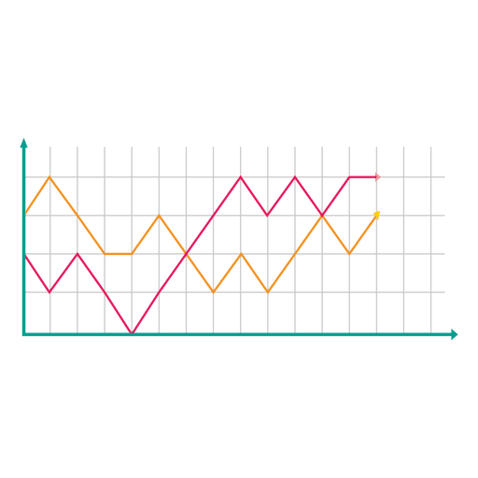
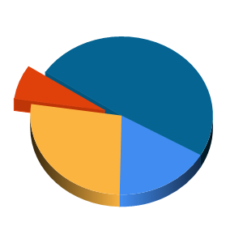
Covid-19 tracker and data visualization
by Atharva Sanjay Katre
This Photo by Unknown Author is licensed under CC BY-SA
This Photo by Unknown Author is licensed under CC BY-SA

Slide 2
Purpose
Covid.info web app is built to track and analyze the Coronavirus global pandemic.
It displays live stats of Covid-19 cases from all over the globe.
Different visualization techniques are used for easier understanding and studying the trend of the pandemic.

Slide 3
Why visualize Covid-19 data?
After doing some research about the data analysis of the ongoing Covid-19 pandemic I found out that there were not many reliable sources which provided real time analysis and visualization of the trend of the pandemic so far.
So… I decided to create an interactive web app for easy and better understanding of the pandemic with the help of available data.

Slide 4
Used Technologies
Django framework
Python for back-end
Plotly and Dash for plotting graphs and choropleth maps
Open source API’s and web scraping for Covid-19 data
Bootstrap for front-end

Slide 5
Django framework
Django App
Logic, Data structures,
Dash apps (plots and graphs)
Templates
Front-end, Html and CSS
Formatted data, plots and maps
User interactions and input
Context and data requests
Data to display
View
Context and template rendering

Slide 6
DATA SOURCES
API
I used different APIs to collect different types of data for this project. Few are listed below:
https://covid19api.com
https://github.com/datasets/covid-19
Web scraping
Also used python’s web scrapping tools for collecting specific data.

Slide 7
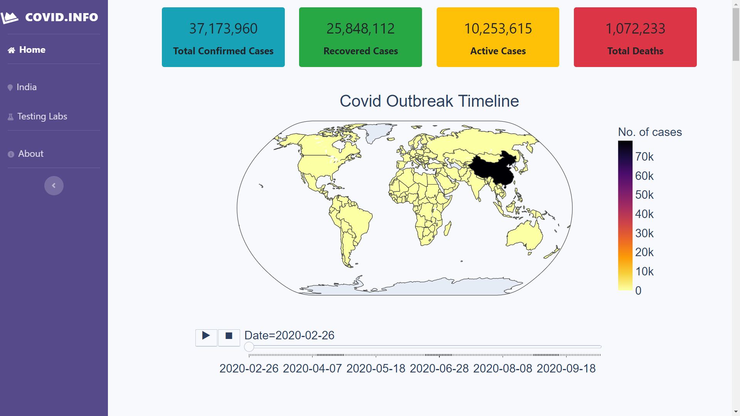
Site Map
Live counters
Global analysis
For India specific analysis
To locate Covid testing labs in India
Plots and maps for data visualization
Link - https://covid19--info.herokuapp.com

Slide 8
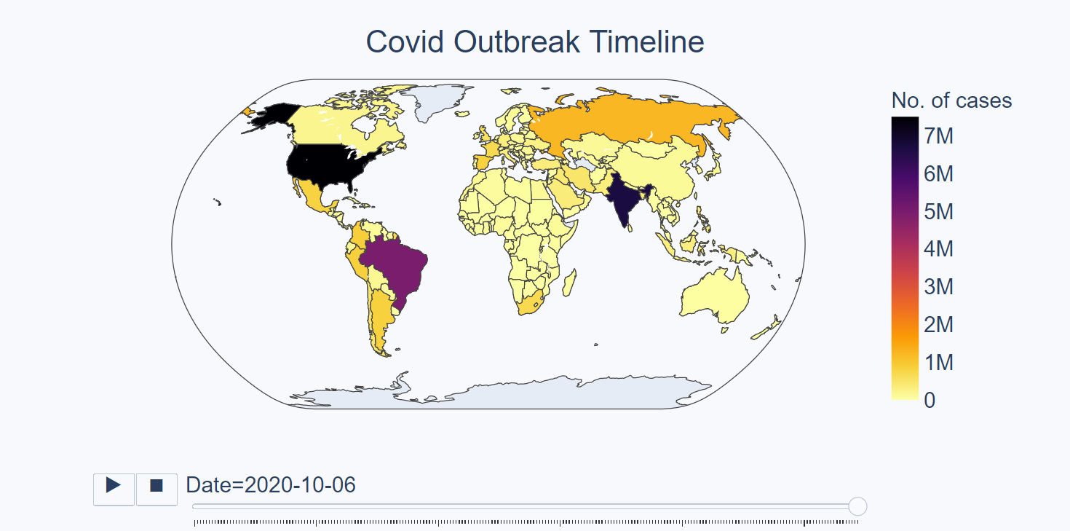
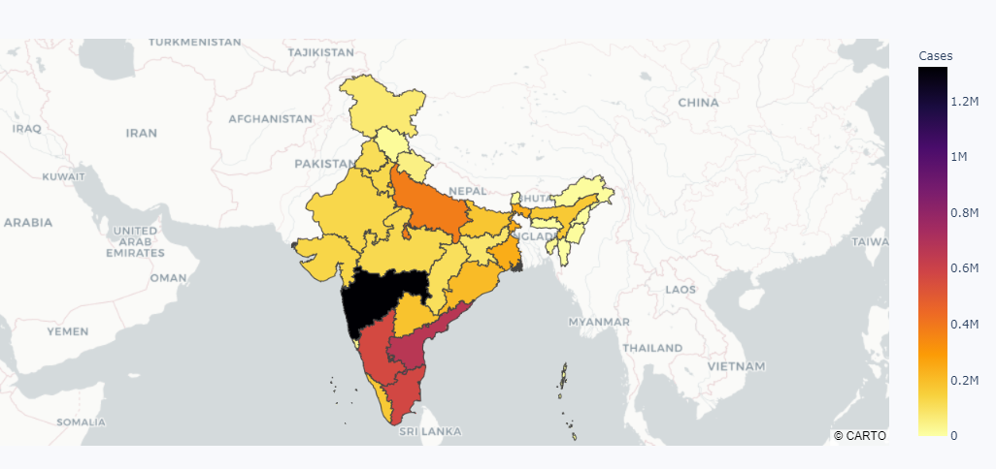
Plots And Maps
Choropleths and Timeseries choropleths

Slide 9
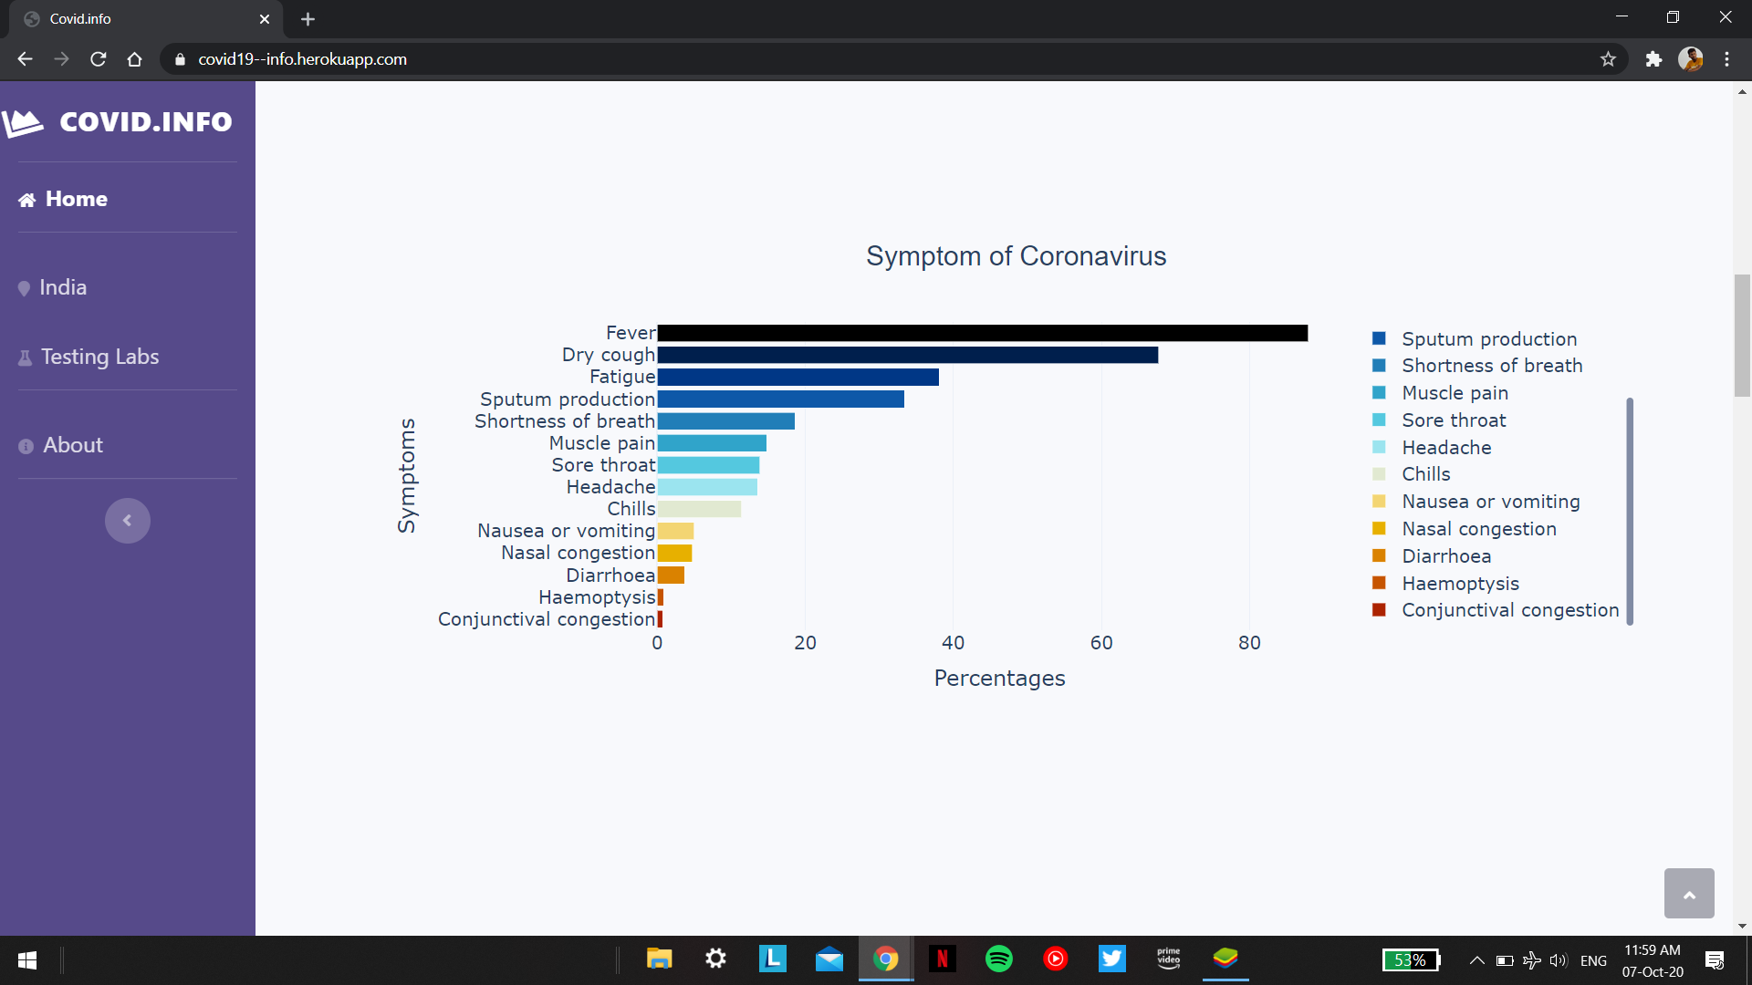
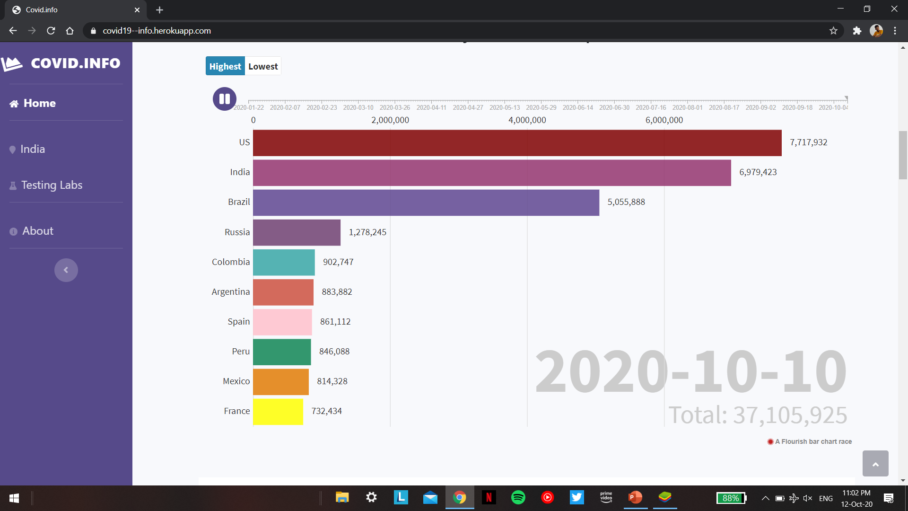
Plots And Maps
Bar graphs
Racing Bar graphs

Slide 10
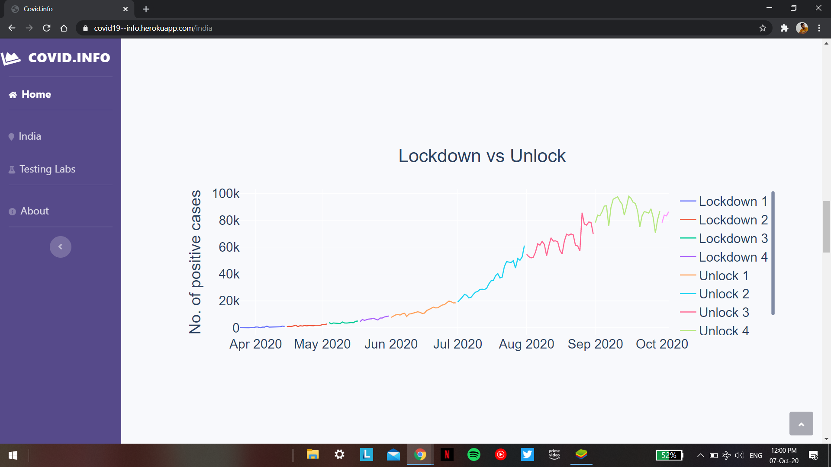
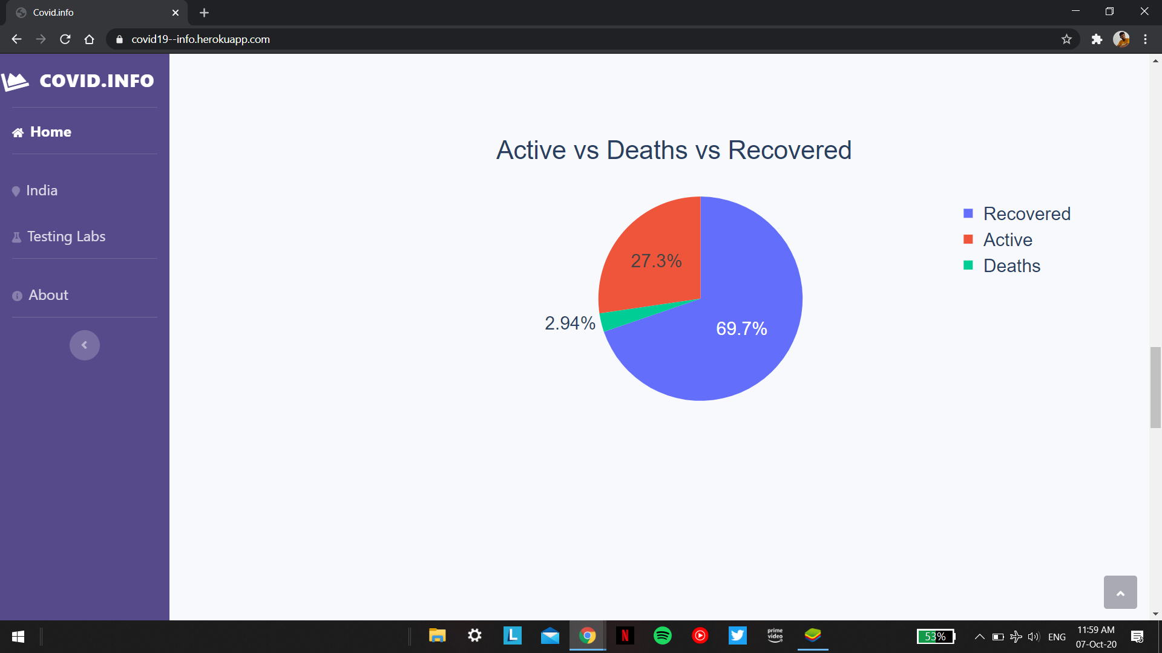
Plots And Maps
Line graphs
Pie charts

Slide 11
Thank you
Source code - https://github.com/AtharvaKatre/covid19info
Project link - https://covid19--info.herokuapp.com
Contact - atharva.katre.71@gmail.com

